Slide 1
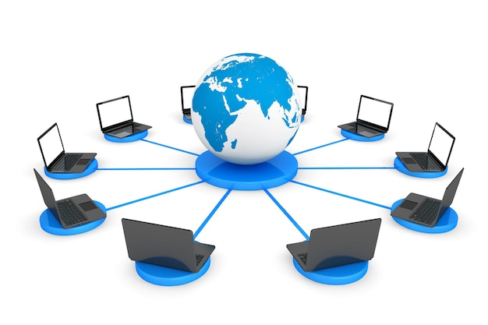
COMPUTER NETWORKS
PRESENTED BY:-
SAKSHI MADAN DESAI:-U15BL23S0375
SHRADHA KOLEKAR:-U15BL23S0203
PRAJAKTA PATIL:-U15BL23S0400

Slide 2
Introduction
Definition :-A computer network is a collection of interconnected devices that communicate with each other to share resources and data.
Purpose :-To share resources, enable communication, and facilitate data exchange.
Types of Networks
PAN: Personal devices (e.g., Bluetooth).
LAN: Small local areas (e.g., offices).
MAN: City-wide coverage (e.g., campus).
WAN: Large areas (e.g., the Internet).

Slide 3
Network Topologies
1.Star Topology: All devices connect to a central hub, which manages communication.
2. Bus Topology: Devices share a single cable as a backbone for data transfer.
3. Ring Topology: Devices are connected in a circular loop, with data flowing in one or both directions.
4. Mesh Topology: Devices are interconnected, providing multiple paths for data.
5. Hybrid Topology: A combination of two or more topologies for flexibility and scalability.

Slide 4
Components of a Network
Hardware: Servers, routers, switches, cables.
Software: Operating systems, protocols (e.g., TCP/IP, HTTP).
Transmission Media: Wired (fiber, coaxial) and wireless (radio waves, microwaves).
Network Security Threats
Malware, phishing, hacking.
Measures: Firewalls, encryption, antivirus, user authentication.

Slide 5
Applications of Networks
Internet access, business communication, online education, IoT.
Examples: Cloud computing, video conferencing, smart devices.
Advantages & Challenges
Advantages: Resource sharing, cost efficiency, communication improvement.
Challenges: Security risks, maintenance costs, scalability issues.
Conclusion
Recap: Importance of computer networks in daily life . Future: 5G, AI in networking, and IoT advancements.

Slide 6
THANK YOU

